Slide 1
Secure data hiding in images steganography
Student Name : SEERA SIVA PRASAD
College Name : VISAKHA INSTITUTE OF ENGINEERING AND TECHNOLOGY
Department : ELECTRONICS AND COMMUNICATION ENGINEERING [ECE]

Slide 2
Problem Statement
Traditional encryption methods may not be enough for data privacy and security.
The need to hide secret data within ordinary images for enhanced protection.
Ensuring that hidden data is imperceptible to unauthorized parties.
Providing a secure communication method in restricted regions.

Slide 3
Technology used
Graphical User Interface (GUI) for ease of use.
Python programming language for tool development.
Open CV library for image processing.

Slide 4
Wow factors
Invisible data embedding with minimal visual distortion.
User-friendly interface for accessible use.
Covert method for secure communication.
Enhanced data protection beyond traditional encryption.
Versatility in applying to various image formats.

Slide 5
End users
Journalists and activists for secure communication.
Corporates and businesses for protecting sensitive information.
General public for personal data protection.
professionals for confidential document sharing.
Government agencies for secure communication.

Slide 6
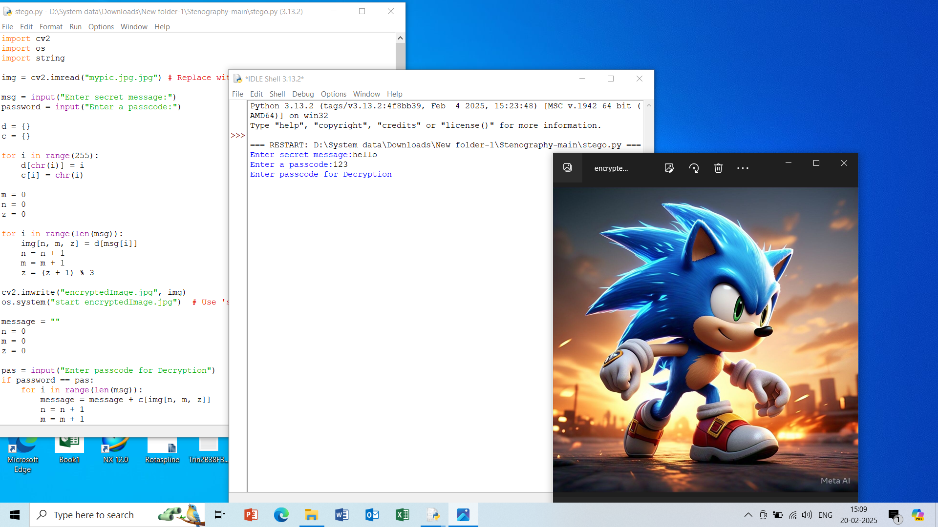
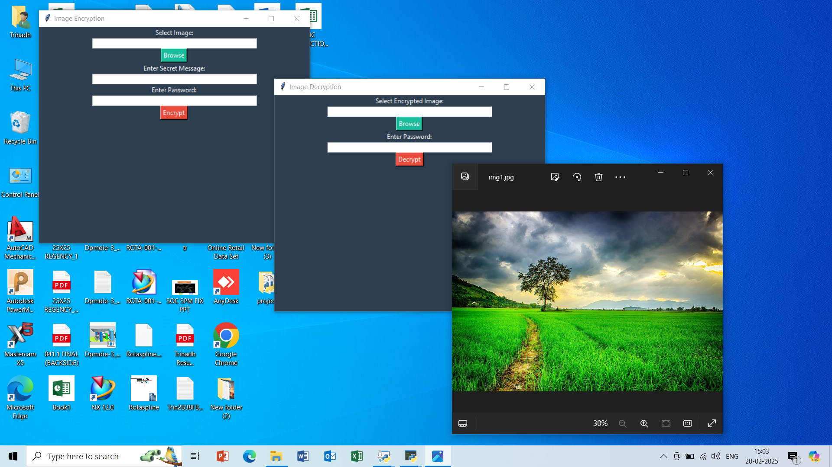
Results

Slide 7
Conclusion
Steganography enhances data privacy and security.
Provides a covert communication method.
Offers a secure way to protect sensitive information.
Ensures hidden data remains imperceptible.
Valuable tool in the digital age.

Slide 8
GitHub Link
secure data hiding in images steganography
https://github.com/sivaseera1/project.git
https://github.com/sivaseera1/Steganography.git

Slide 9
THANK YOU

